Slide 1
IDEA SUBMISSION - Round 1
IDEA TITLE : SMART ECO-FRIENDLY EXTERNAL VISUAL DISPLAY ON VEHICLES

Slide 2


PLEDGE TO PROGRESS Sustainability Hackathon
Sponsored By
Team Name : Digital Artists
Team bio : We strive to reduce carbon footprint by disrupting traditional marketing methods through our moonshot product idea using our use-case in the automobile industry.
Date : 24 Apr 2023

Slide 3
EXTERNAL DISPLAY TECHOLOGY FOR VEHICLES - A SUSTAINABLE FUTURE TECHNOLOGY
The automobile industry is now being shaped by electrically powered vehicles due to
Depleting resources
Increase in greenhouse effects
Pollution
Life-Time Ownership Value
The future may also be revolutionized by flying cars for which many prototypes are being tested by researchers in different parts of the globe.
Solar or other renewable/clean forms of energy combined with innovative display technology can be adopted for utilizing the exterior surface of private and public vehicles as a digital advertisement space.
This alternative option will help reduce carbon emissions observed in traditional methods. This is going to be a huge opportunity once concepts like self-driving cars become a reality.

Slide 4
OUR SOLUTION V/S CURRENT TRENDS
The rise in entrepreneurial wave across the globe, “Make in India” and “Startup India” initiatives are churning new ideas and products using novel techniques. Also, providing near-real-time information/news has become the need of the hour. Marketing leaders are also constantly looking for ideas that would help them relay their communication in a more proactive and real-time manner.
As of now there is no concurrent organised competition existing in the world. This is a novel concept. Technology such as nanopaints is expected to be very expensive and poses implementation challenges. Also the nano paints is just a visual enhancement feature and doesn’t address the real-time needs and is hence not a sustainable technology in the long run.
Companies usually have chosen to display advertisements on electronic hoardings which obviously require separate power supply. Also, bottleneck locations are not targetable by all forms of media excepting print media, certain innovative online platforms and television commercials. It costs a huge amount for the manufacturers in terms of advertisement fee, brand ambassador charges and several others. Still the viewership is limited and impact of the campaign is low.

Slide 5
Plan of Action:
External Space on Vehicles
Display Technology
AI/ML, Cloud & Networking
Utilising technologies of the future practically for information mobility and disaster management
Providing Reusable Surface area for Information to be published.
Developed using low power consumption technology and using renewable energy wind/solar on a moving vehicle

Slide 6
SUSTAINIBILITY CAUSE - POINT OF VIEW
Urban emissions is one of the prime factors that has led to climate change. Considering the traditional forms of advertising, this solution presents a safer re-usable physical marketing spots.
Digital technology will disrupt every area including marketing and this is clearly visible from technology such as LED boards in market centers. This technology could make the job of a marketeer much easier and can prove to be a breakthrough if an OEM is developed furthering the concept. It presents a great opportunity to compete with current trends of web/print marketing and also can prove to be a great tool for information management.
The multi-functional display enabled external parts replaces the traditional metallic body surface with fabricated material based OLED or similar screen which helps in reducing the carbon footprint and preserves natural resources for future generations.
Future technologies shall cater to the needs of future. This external displaying option in vehicles of future could be an ultimate necessity considering the current challenges and the opportunities we have with improvements in cloud & internet technology.

Slide 7
TOOLS, RESOURCES NEEDED TO DEVELOP & TEST PROTOTYPE
Hardware Requirements: A used vehicle two/four wheeler(conditional to availibility). Electronics tools, networking devices, etc. with chip development & testing facility for Developing a low power consumption display technology. Software & Internet tools: Azure IOT and Azure Networking services are required for enabling inter-connected device framework to be implemented in product design. Azure Sphere & Azure RTOS will be utilised for designing & testing. Consumer database management & prototype test data would make use of SQL Studio (SSMS). MS SQL will be used as Backend database sever with Microsoft AI applications. One Drive & Microsoft Azure for cloud implementation to make real time information available. Microsoft Teams & Office for virtual team collaboration & project management.

Slide 8
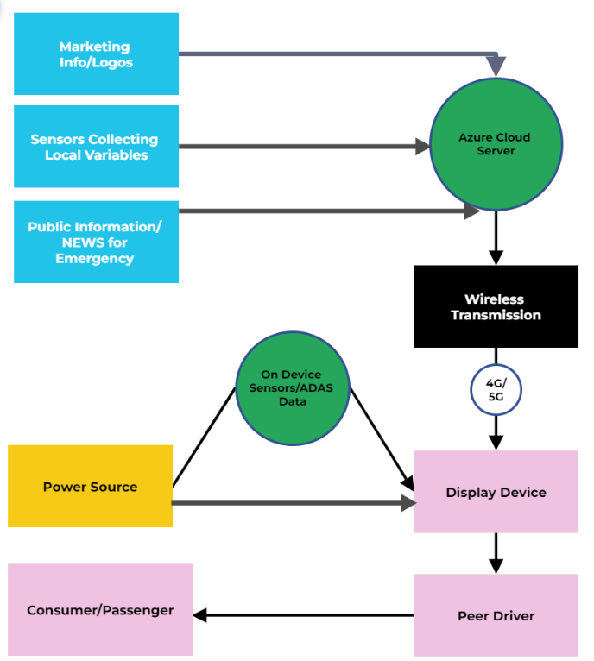
PRODUCT ARCHITECTURE, DESIGN & FUNCTION
SQL Server
(Backend Database)

Slide 9
ADOPTING TARGET SEGMENT & CRITICAL FACTORS
Initially the user segment that could be identified is the mobility tech firms as a marketing platform to target the right customer in right location and at the right time.
Govt. services could be the prime consumer of the technology to broadcast road status, climate conditions, other emergency information such as ambulance passing by or nearby information instantly at the correct places.
It could further be adopted Construction/Infra firms for preventing accidents and broadcasting critical information.
In later stages with the self-driving and automated cars coming in the common car-owner individual could be targeted as this would create a need for such a platform that engage the consumer appropriately.
Age factor could be ignored here, as the youngsters & aged should be equally curious to get to see their vehicles light up. Yes there could be resistance by governments initially it is debatable that this technology could be implemented keeping in view traffic rules. But ultimately it is for the better and sustainable future. The level of impact it could bring could be similar to what mobile phones brought!

Slide 10
APPLICATIONS
The ability to display critical and valuable information instantly on a wide spread scale and in specific areas will no doubt help the government and authorities for better provision of services and maintenance of order in haphazard conditions or emergencies. This could be a life saver in Hilly terrains & remote areas for safer operations with the increasing logistics requirements.
Even for the huge equipment used in the civil/infra projects such as roadways or railways construction to prevent the accidents by making the real-time information available to the engaged stakeholders. Also for the oil & gas tankers it could address the fellow drivers on the road with the real time information.
The advertisement on vehicle’s space can be the obvious idea for the sustainable future competition among the automobile companies, although currently being practiced but not on as massive scale and without any OEMs. Hence there arises a need for designing such a renewably powered display device and setting up a SOP in this space which can appropriately be used for the betterment of mankind.
Visual enhancement is of course a feature which could be considered for launching Make To Order products for amateurs.

Slide 11
FUTURE SCOPE AND SCALIBILITY
How far it can go?
Sky is not even the limit if the technology gets implemented and executed properly. The eventual adoption could be progressed to airplanes, trains, metros and who knows soon enough to flying cars (if they develop it soon). OEMs could be brought out creating a whole new arena of competiotion in the future.
The marketing giants including franchisee businesses would surely be interested for its implementation on a widest scale.
The arrival of self-driving cars in the scenario will provide the scalability for the market as the user will be available to actively indulge in the outside space once they are accessing the ease of sitting in a vehicle without driving it.
Anyways the public transport market already exists providing a reasonably good platform to trial the innovation for market-fit as it could primarily replace the paper & paint in the poster-market with a reusable space and with one time installation.

Slide 12
Thank You!
Rahul Dogra – Product & Design Engineer
Rahul Kadgavkar – Cloud/IT Engineer
Amit Nilajkar – Sr. Software & Web Expert
Koushik Karan – Electronics & IOT Engineer
Veena Viswanathan – Analytics & Stakeholder Expert
Secondary/External Support: Mohammed Aamid – Mechanical Design Expert (Technical Advisor)

